Slide 1


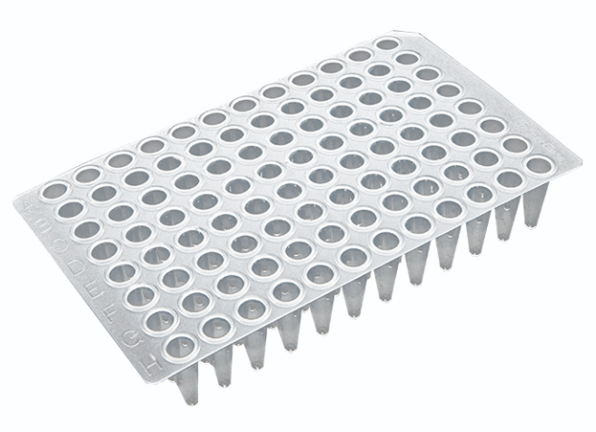
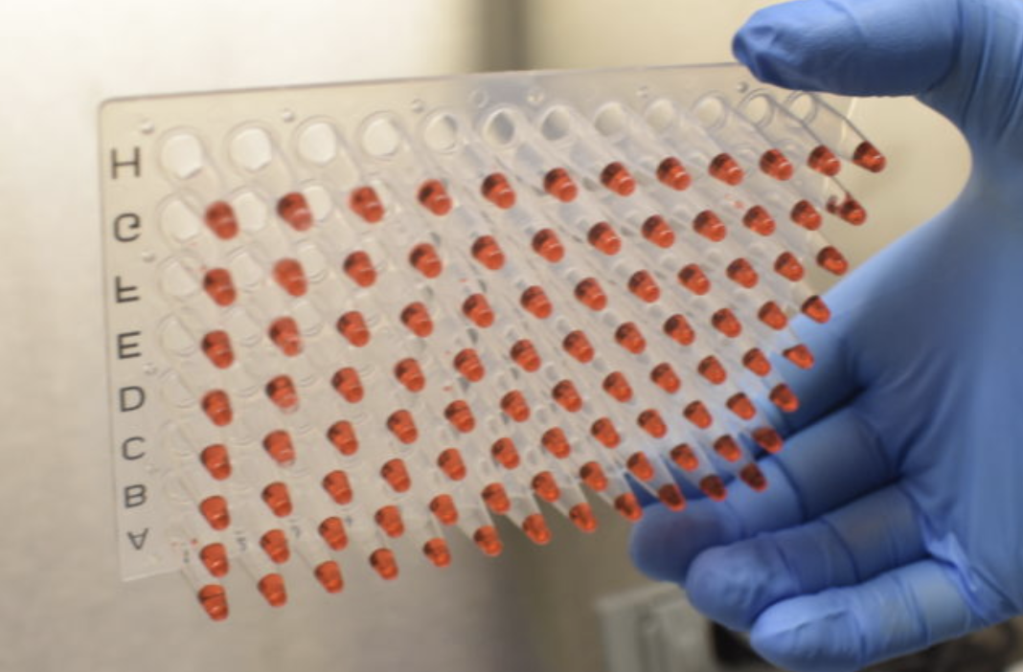
FloodLAMP QuickColorTM COVID-19 Test Flow
Pooled Dry Swab Samples
Heat 95°C 5mL: 8 min
1.5mL: 5 min
Saline
1)
INACTIVATION
SOLUTION
100X Inactiv
Solution
Let Cool
5mL: 10 min
1.5mL: 5 min
Primer Solution
Heat 65°C for 25 min
2)
REACTION
MIX
Color LAMP Master Mix
Samples added to Reaction Mix

Slide 2
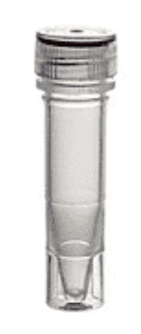
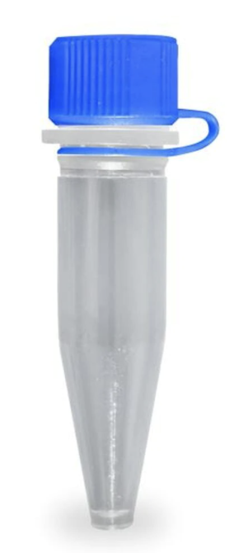
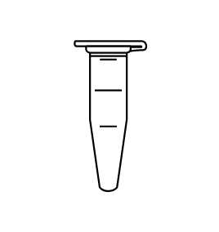
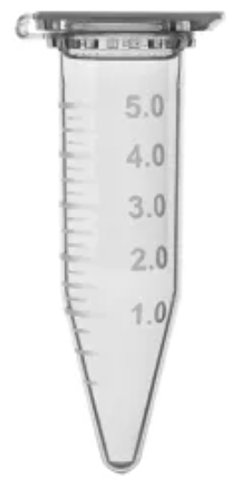
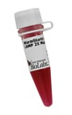
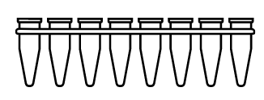
FloodLAMP QuickColorTM COVID-19 Test Diagram
1X Inactivation Saline Solution
Amplification Reaction Mix
1.5 mL Tube
Reaction Mix Prep: Quick Reference
# Reactions | 8 | 16 | 24 | 48
PGS (µL) | 92 | 183 | 275 | 550
LAMP MM (µL) | 109 | 218 | 328 | 655
Primer Solution (PGS)
500 µL
92 µL*
Colorimetric LAMP MM (NEB M1804)
CLAMP Reaction
Mix
100X Inactivation Solution
+ 23 µL Reaction Mix
per tube
.9% Saline
50 mL
110 µL*
8 reactions*
Heat 65°C for 25min
1,000 µL
Pos and Neg Controls
RESULTS!
1X Inactivation
Saline Solution
~50 mL
Pooled Dry Swab Samples
STEP #2
+ 2 µL Sample
Heat 95°C for 8min
Cool at Room Temp for 10min
Eluted Sample
1,000 µL
STEP #1

